Slide 1
Universitatea Tehnică din Cluj-Napoca

Slide 2
Welcome to
trendence 2015

Slide 4




Slide 6
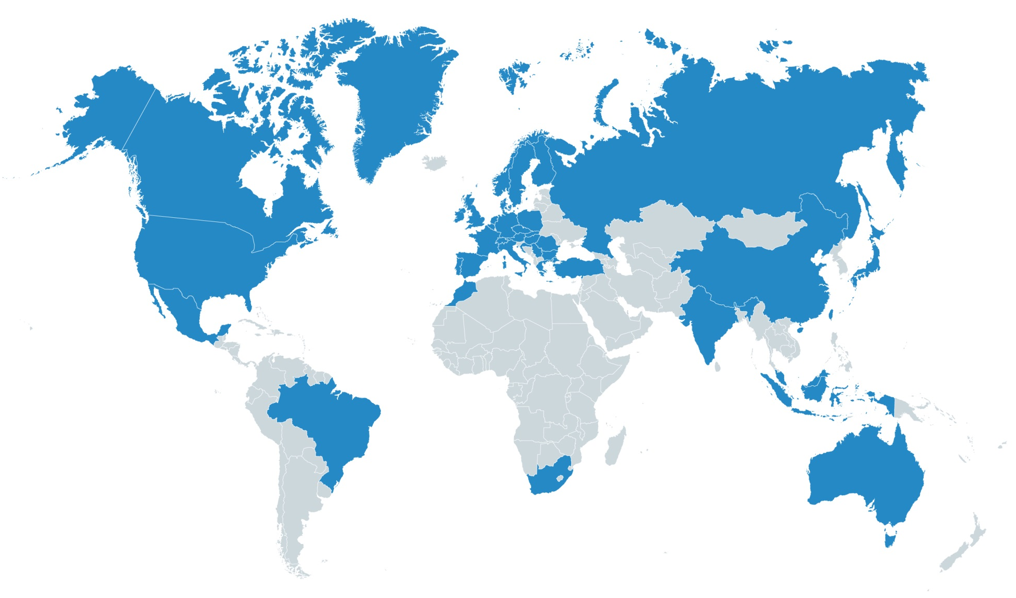



trendence worldwide
School leavers
Graduates
Professionals
over 500,000 participants
over 1,000 universities
worldwide

Slide 23
1.
2.
3.
4.
5.
6.
7.
8.
9.
10.

Slide 53
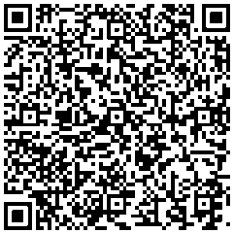
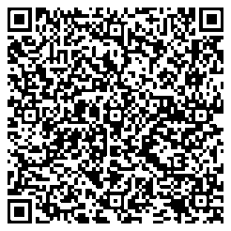
Contact
Contact:
Christine Dietzsch
Head of Partner Relations
christine.dietzsch@trendence.com
+49 30 2592988 311
trendence Institut GmbH
Markgrafenstrasse 62
10969 Berlin
Germany
Contact:
Ditte Lorenz
Project Coordinator
ditte.lorenz@trendence.com
+49 30 2592988 603
trendence Institut GmbH
Markgrafenstrasse 62
10969 Berlin
Germany

